Slide 1
Code execution and peer review make reproducibility possible
Introduction @ CODECHECK and TU Delft Hackathon
Sep 2023
Daniel Nüst, Stephen Eglen & all CODECHECK supporteers
https://bit.ly/check-delft
Notes:
Should be “inspiring”

Slide 2
Closed and irreproducible research
✔️
❌
🎓
❌
⁉️
♻️
❌
💡
❌
Notes:
Here are some of the problems with closed and irreproducible research:
It cannot be fully understood nor 🖱️ verified.
It obstructs effective 🖱️ reuse and extension, therefore it is not sustainable.
It prevents usage in 🖱️ education and citizen science.
And it slows 🖱️ innovation through closeness and repetition.

Slide 3
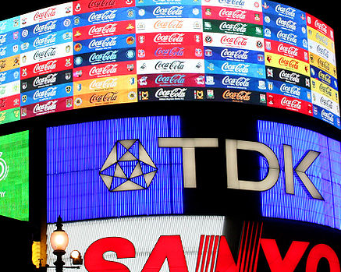
Claerbout’s claim:
An article about computational science in
a scientific publication is not the
scholarship itself, it is merely advertising
of the scholarship. The actual scholarship
is the complete software development
environment and the complete set of
instructions which generated the figures.
https://doi.org/10.1190/1.1822162
https://doi.org/10.1007/978-1-4612-2544-7_5
CC-BY 3.0, Sebastian Bertalan, Wikimedia Commons
Notes:
This is of course also the case for all AGILE and Earths System Sciene papers that use data and code.

Slide 4
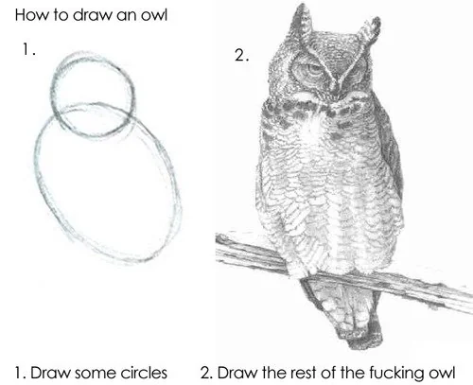
https://www.reddit.com/r/pics/comments/d3zhx/how_to_draw_an_owl/
Notes:
https://amp.knowyourmeme.com/memes/how-to-draw-an-owl

Slide 5
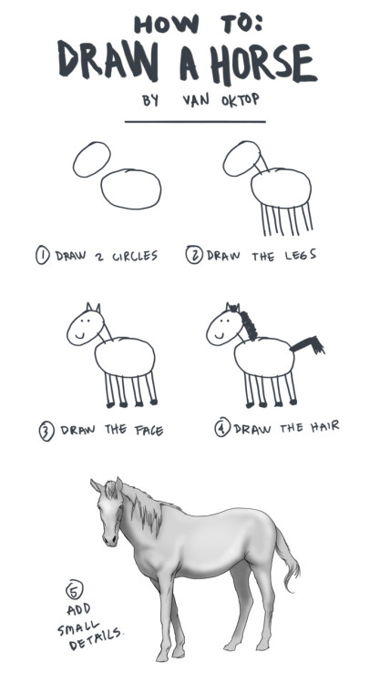
https://oktop.tumblr.com/post/15352780846
Notes:
https://amp.knowyourmeme.com/memes/how-to-draw-an-owl

Slide 6
One thing
Have a README: all else is details.
Show willingness to help, but don’t stop publishing because lacking docs.
Hard to document for someone else > document for future you, add more on demand.
Rule 1 inspired by Greg Wilson’s Teching Tech Together (http://teachtogether.tech/en/index.html) Rule 1.

Slide 7
Four things on reproducible research
Have a README: all else is details.
Have a colleague run your workflow before submission.
Reproduce papers (or return the favour 👆).
Publish code and data, cite it.
Rule 1 inspired by Greg Wilson’s Teching Tech Together (http://teachtogether.tech/en/index.html) Rule 1.

Slide 8
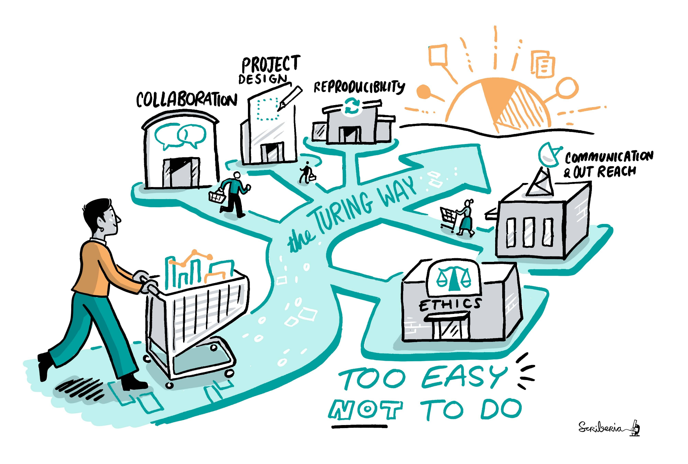
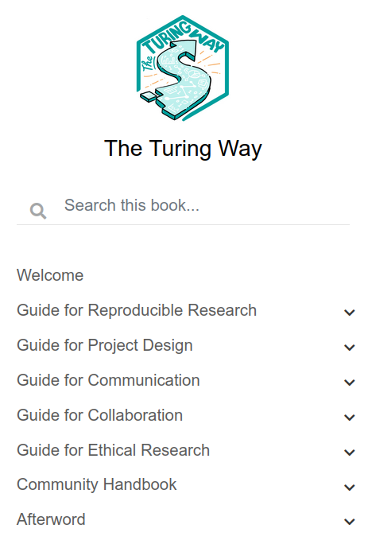
The Turing Way > https://the-turing-way.netlify.app/
The Turing Way project illustration by Scriberia. Zenodo. http://doi.org/10.5281/zenodo.3332807¶

Slide 9


Reproducible Research
Peer Review
Reproducible research and peer review are cornerstones of science. But are they getting along?
https://giphy.com/gifs/suspicious-YNEpBZC0Ly08M https://giphy.com/gifs/lol-futurama-humor-cFgb5p5e1My3K
Notes:
It sometimes seems like reproducible research and peer review are not getting along, they might even suspiciously eye each other.
If software is so important for science, why is it largely neglected during peer review?
The easy answer is simply it is “extra work”, but I think it is worth noting that the lack of reproducibility during peer review is just one of many challenges that science faces.
My important message for today: reproducibility is something that actually can, and should, be determined as part of a peer review process!
In the rest of the talk, I will present two community-led approaches to increase reproducibility. Then, I’ll try to provide a brief overview of what you can do as a researchers to work more reproducibly.

Slide 10
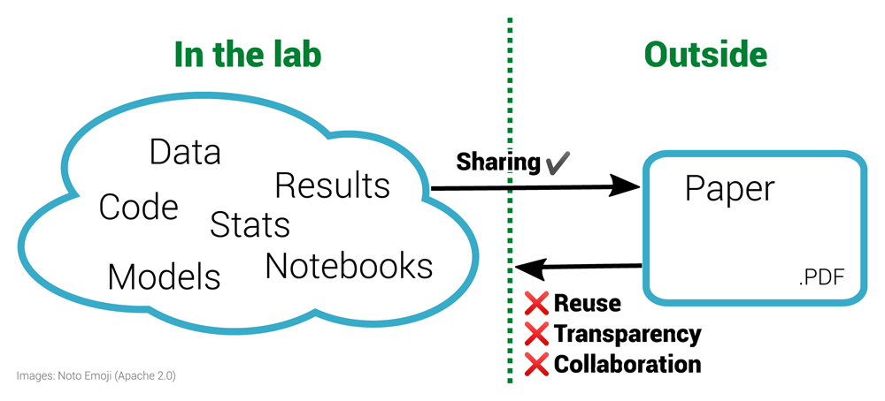
The inverse problem in reproducible research. Figure 1 of https://doi.org/10.12688/f1000research.51738.1
The left half of the diagram shows a diverse range of materials used within a laboratory. These materials are often then condensed for sharing with the outside world via the research paper, a static PDF document. Working backwards from the PDF to the underlying materials is impossible. This prohibits reuse and is not only non-transparent for a specific paper but is also ineffective for science as a whole. By sharing the materials on the left, others outside the lab can enhance this work.
Notes:
CODECHECK is motivated by the already mentioned breakage in science. We do not share all the building blocks of research, but communicate via, effectively, printed documents. This prohibits reuse and collaboration. It is simply ineffective, a waste of time and money.

Slide 11
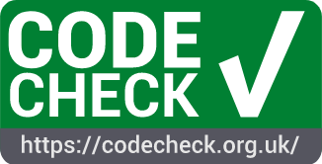
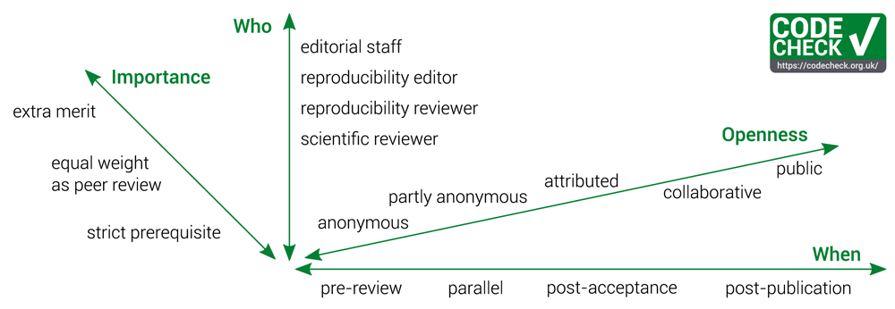

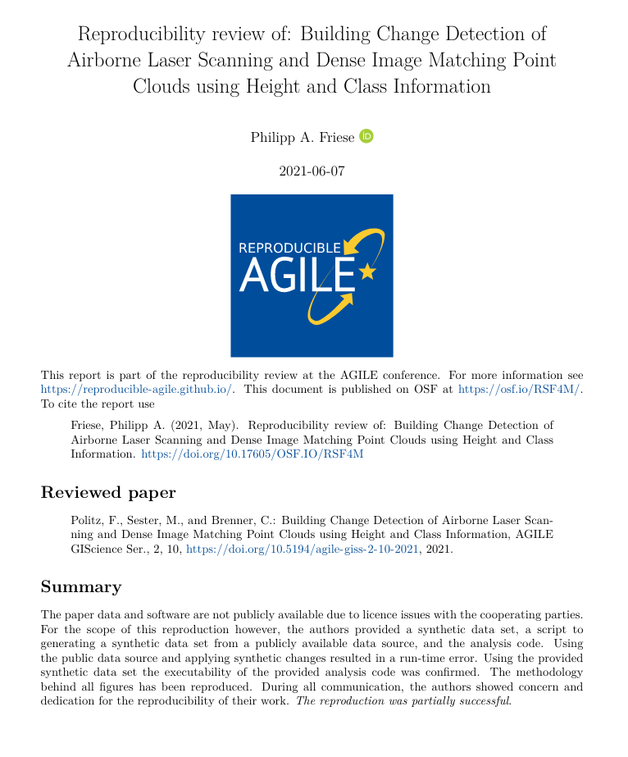
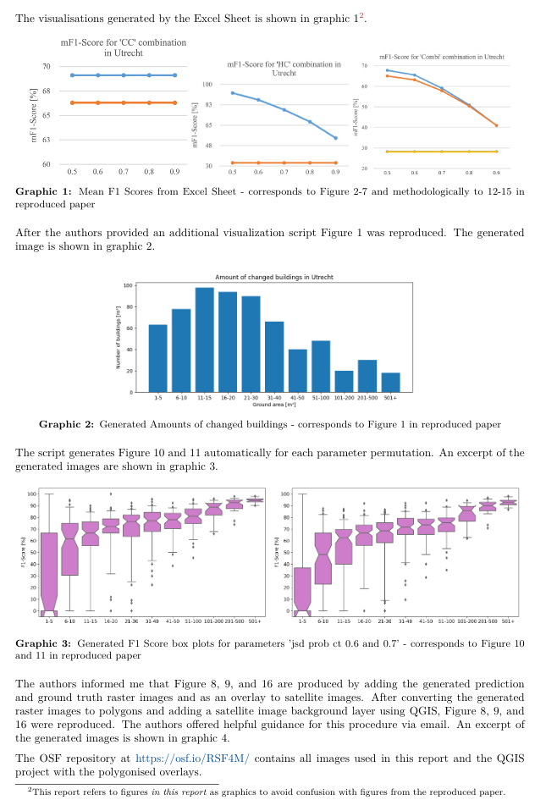
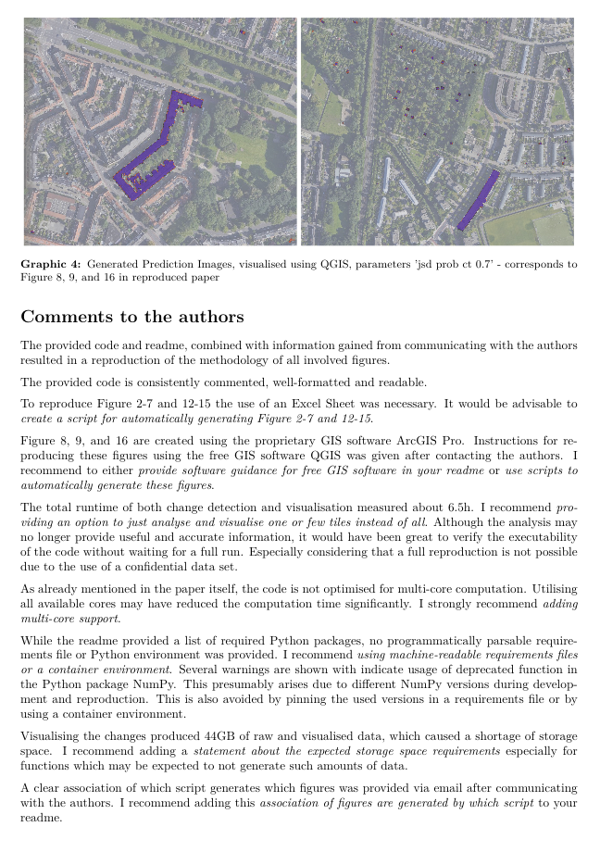

One re-execution of computational workflow by codechecker during peer review
Codecheckers record but don’t investigate or fix.
Communication between humans is key.
Credit is given to codecheckers.
Workflows must be auditable.
Open by default and transitional by disposition.
Independent execution of computations underlying research articles.
👶
🔏
50+ Certificates https://codecheck.org.uk/register/
The CODECHECK variations. Figure 1 of https://doi.org/10.12688/f1000research.51738.1
Notes:
A CODECHECK means that a single person, the codechecker, is able to execute a computational workflow at one point in time using the material provided by the author. The codechecker should not get relevant errors doing so, and get results that are not contradicting the original results. This is by design a very limited scope. It places little burden on the authors - they share what they have, and puts the trust in a person instead of requiring infrastructure or technological expertise. Just like peer review puts its trust in researchers as reviewers. CODECHECK’s scope gives flexibility, no standards or specific infrastructure is needed.
CODECHECK is built on five principles: [...]
If a CODECHECK is completed, there is a badge
and a certificate that we publish in a citable way with a DOI.
To date, 30 such certificates have been published, in which the codechecker shares their personal evaluation openly and transparently.
A CODECHECK can be implemented in many ways, varying depending on the existing procedures of journals or common community practices.
It can not only happen at different points in time or varying degrees of openness and power or importance, but also can be completed by different roles. Especially
early career researchers could be excellent candidates to be introduced to peer reviewing in this way. More importantly, they often have the required up-to-date expertise in technology and a large interest in learning methods, not just evaluating them. And the learning experience is one of the main motivation we are told that volunteer codecheckers are interested in, and one I can personally confirm - if you reproduce someone else’s work, you always learn something, and always can contribute back something.
-------------------------
1. Codecheckers record but don’t investigate or fix.
The codechecker follows the author’s instructions to run the code. If instructions are unclear, or if code does not run, the codechecker tells the author. We believe that the job of the codechecker is not to fix these problems but simply to report them to the author and await a fix. The level of documentation required for third parties to reproduce a workflow is hard to get right, and too often this uncertainty leads researchers to give up and not document it at all. The conversation with a codechecker fixes this problem.
2. Communication between humans is key.
Some code may work without any interaction, e.g. 21, but often there are hidden dependencies that need adjusting for a particular system. Allowing the codechecker to communicate directly and openly with the author make this process as constructive as possible; routing this conversation (possibly anonymously) through a publisher would introduce delays and inhibit community building.
3. Credit is given to codecheckers.
The value of performing a CODECHECK is comparable to that of a peer review, and it may require a similar amount of time. Therefore, the codechecker’s activity should be recorded, ideally in the published paper. The public record can be realised by publishing the certificate in a citable form (i.e., with a DOI), by listing codecheckers on the journal’s website or, ideally, by publishing the checks alongside peer review activities in public databases.
4. Workflows must be auditable.
The codechecker should have sufficient material to validate the workflow outputs submitted by the authors. Stark²² calls this “preproducibility” and the ICERM report¹¹ defines the level “Auditable Research” similarly. Communities can establish their own good practices or adapt generic concepts and practical tools, such as publishing all building blocks of science in a research compendium (cf. https://research-compendium.science/) or “repro-pack”²³. A completed check means that code could be executed at least once using the provided instructions, and, therefore, all code and data was given and could be investigated more deeply or extended in the future. Ideally, this is a “one click” step, but achieving this requires particular skills and a sufficient level of documentation for third parties. Furthermore, automation may lead to people gaming the system or reliance on technology, which can often hide important details. All such aspects can reduce the understandability of the material, so we estimate our approach to codechecking, done without automation and with open human communication, to be a simple way to ensure long-term transparency and usefulness. We acknowledge that others have argued in favour of bitwise reproducibility because, in the long run, it can be automated (e.g., https://twitter.com/khinsen/status/1242842759733665799), but until then we need CODECHECK’s approach.
5. Open by default and transitional by disposition.
Unless there are strong reasons to the contrary (e.g., sensitive data on human subjects), all code and data, both from author and codechecker, will be made freely available when the certificate is published. Openness is not required for the paper itself, to accommodate journals in their transition to Open Access models. The code and data publication should follow community good practices. Ultimately we may find that CODECHECK activities are subsumed within peer review.

Slide 12
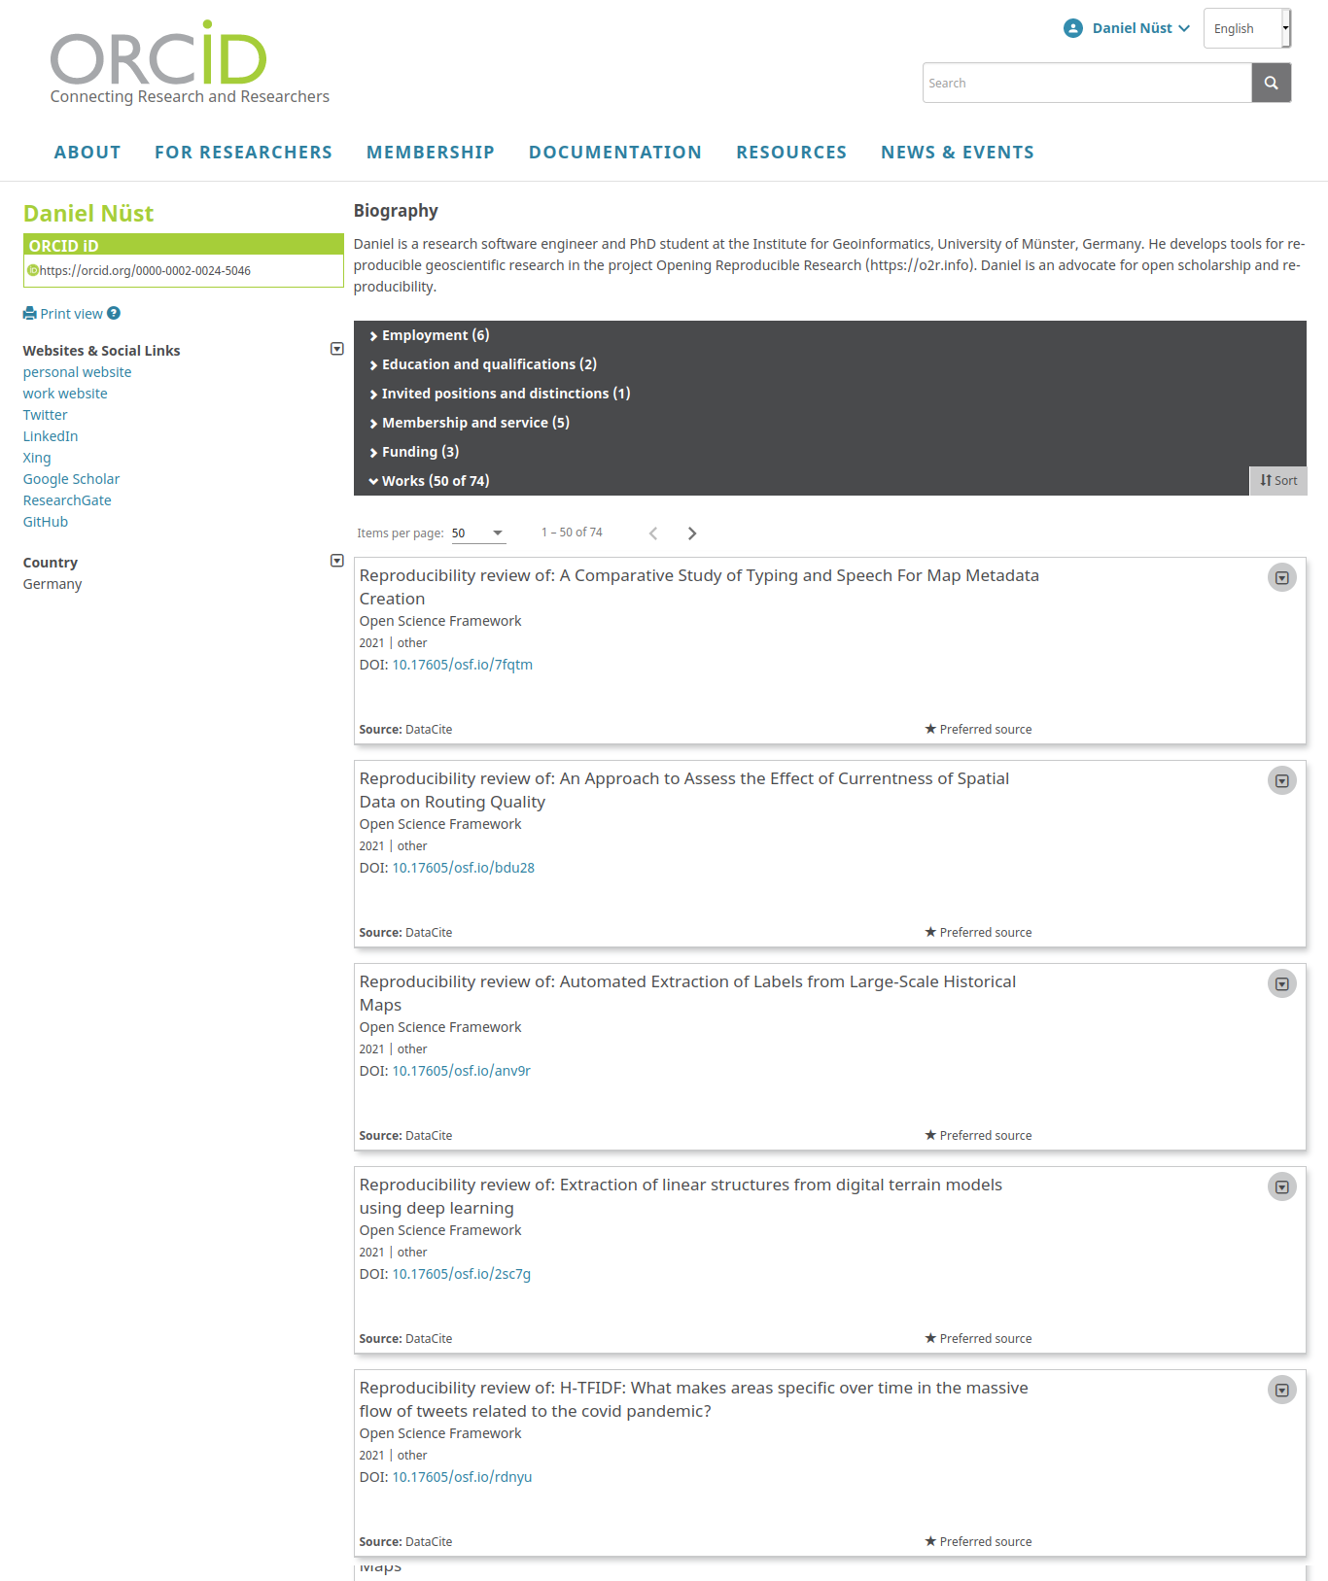
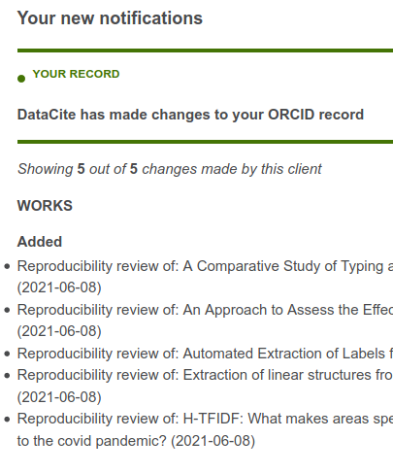
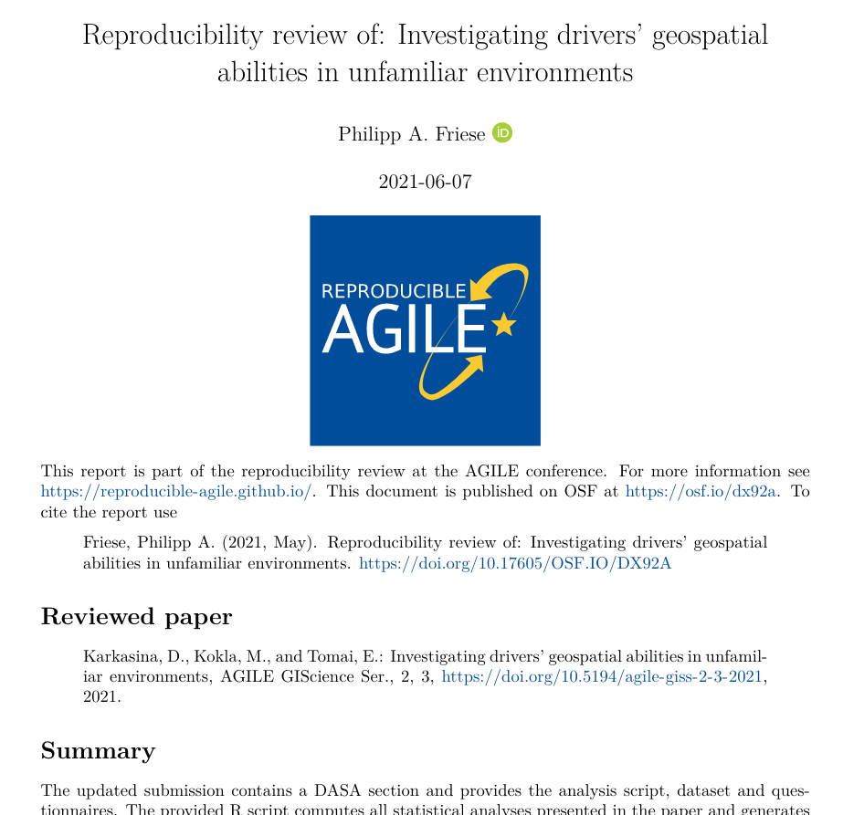
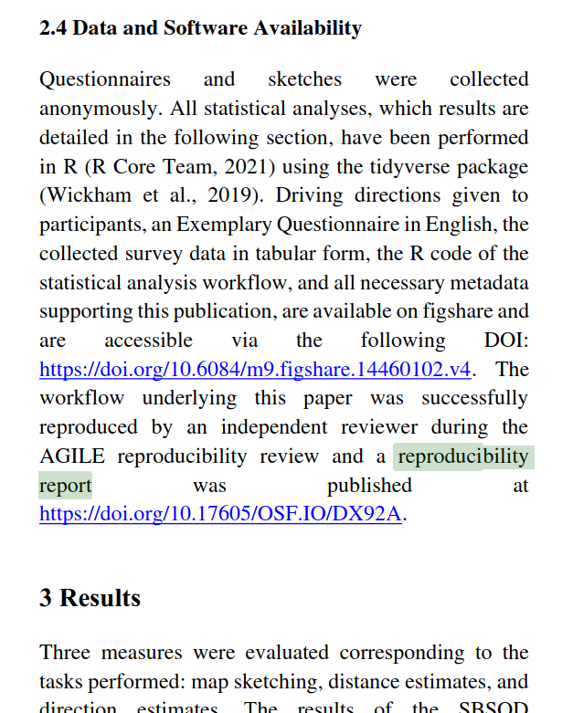
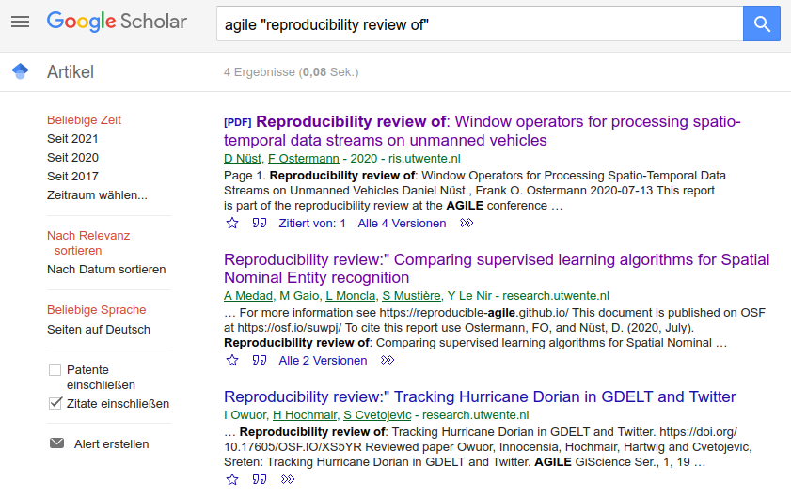
CODECHECK certificates
(= AGILE Reproducibility Reports)
Published with a DOI
Title page, cites the paper
Paper links to report via URL/badge (no citation)
Automatically added to ORCID profile

Slide 13
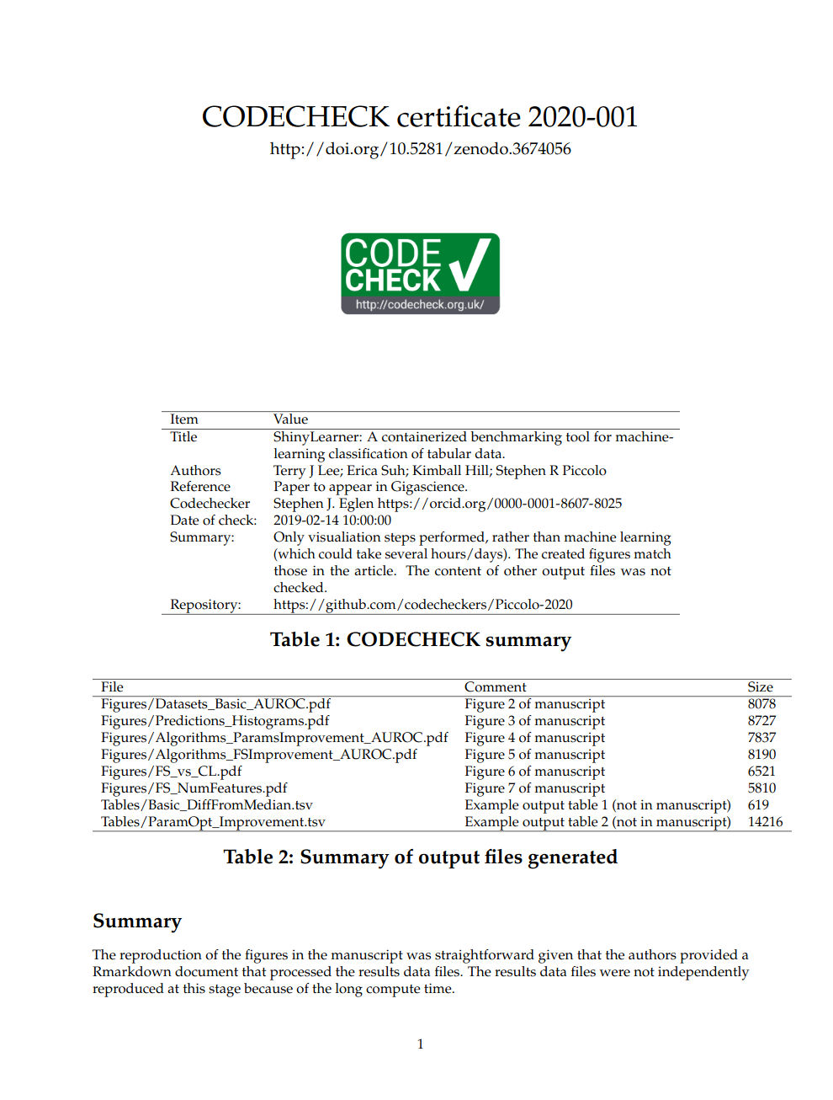
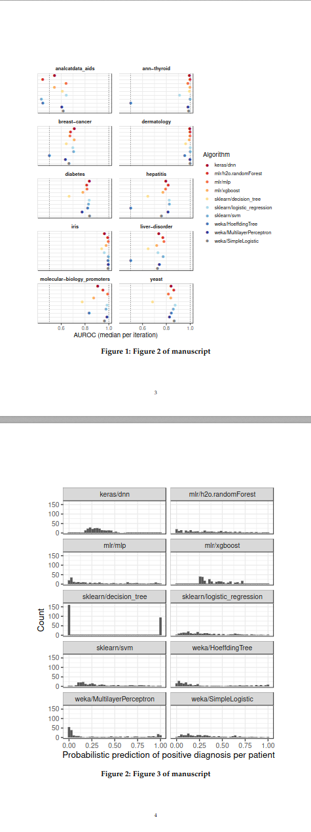
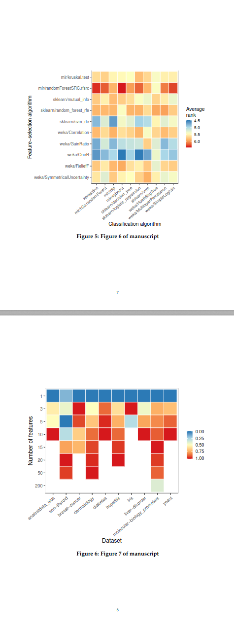
http://doi.org/10.5281/zenodo.3674056

Slide 14
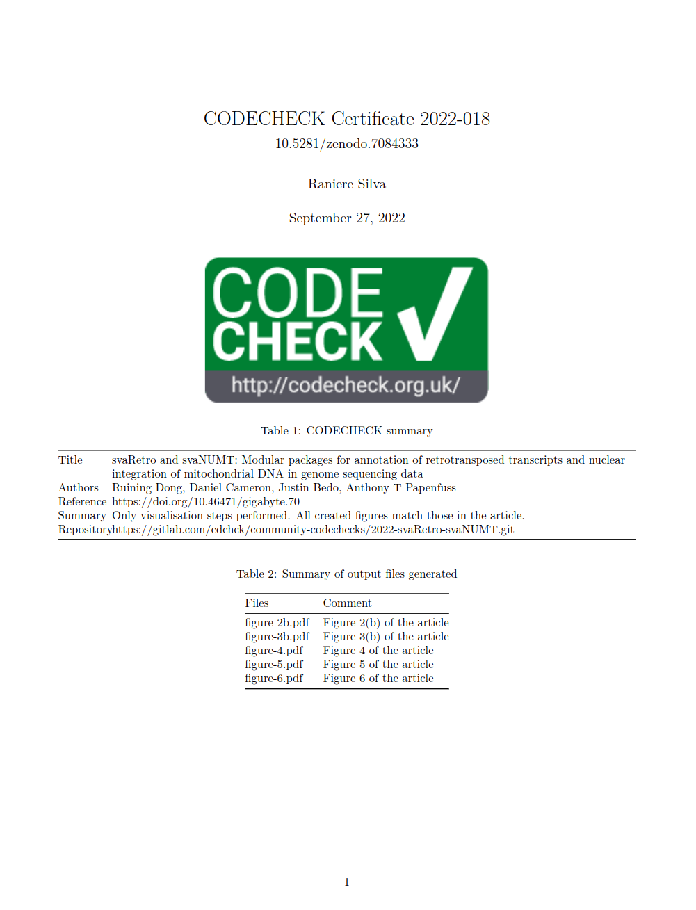
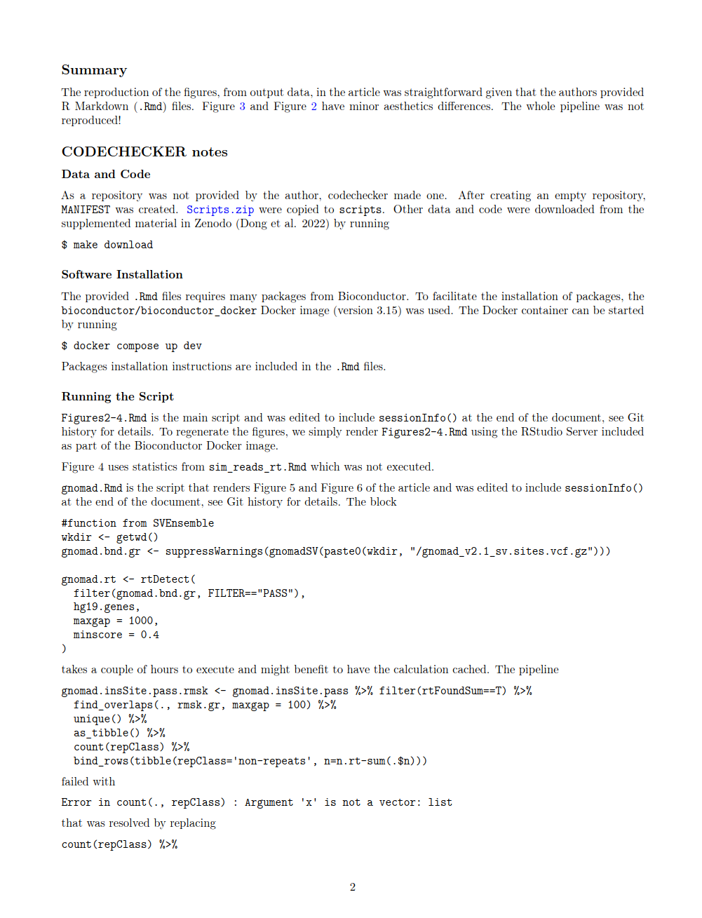
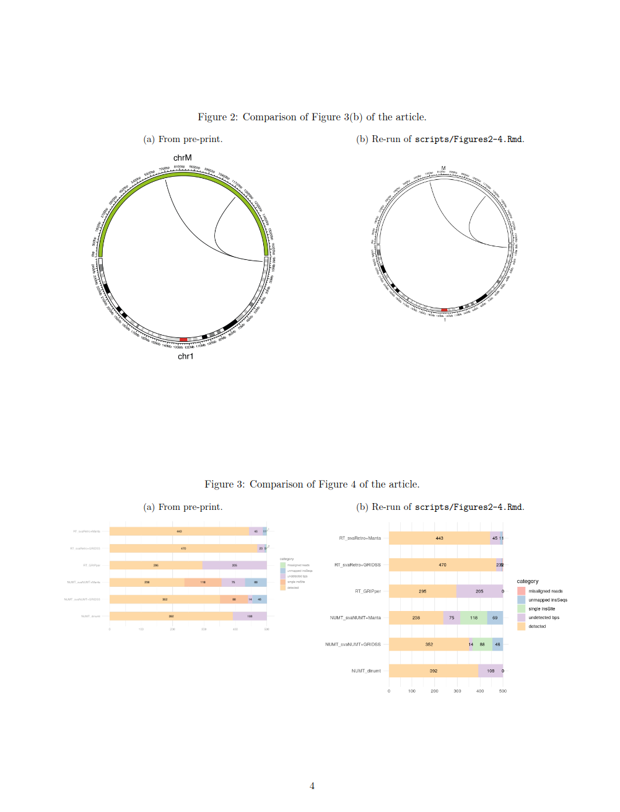
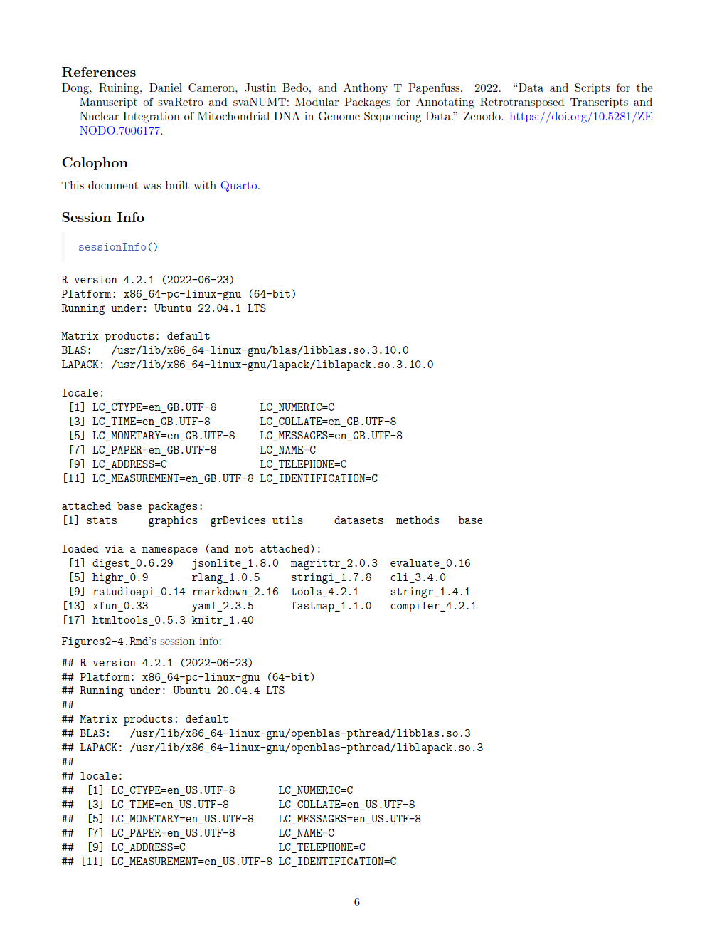
https://doi.org/10.5281/zenodo.7084333

Slide 15

What can you do today?
Notes:
Mindset MORE important than tools.
So, it is really hard to make predictions about peer review, because, well, we can’t see into the future.
Here are a few things that I want to invite you start doing today.

Slide 16
Learn how to
CODECHECK and join a local community of codecheckers to shift practice one paper at a time. https://codecheck.org.uk/
Notes:
The first project is called CODECHECK.

Slide 17
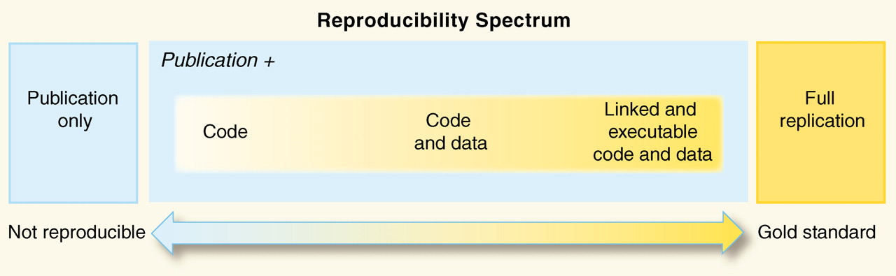
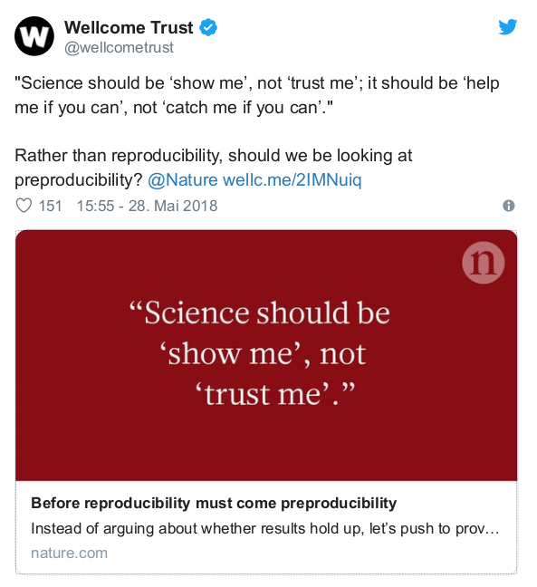
Reproducible Research & Open Science
https://doi.org/10.1126/science.1213847
https://www.nature.com/articles/d41586-018-05256-0
Notes:
Reproducibility Spectrum by Roger Peng
------
Preproducibility ist ein Neologismus von Philip B. Stark als als Alternative zu den verwirrenden oder unterschiedlich interpretierten existierenden Begriffen, nämlich: "An experiment or analysis is preproducible if it has been described in adequate detail for others to undertake it. Preproducibility is a prerequisite for reproducibility, and the idea makes sense across disciplines. [...] Science should be ‘show me’, not ‘trust me’; it should be ‘help me if you can’, not ‘catch me if you can’." Lesenswert: 10.1038/d41586-018-05256-0 !

Slide 18
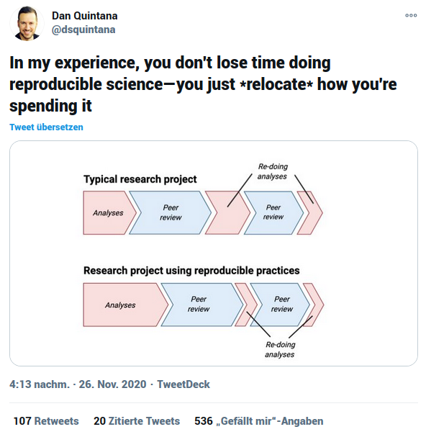
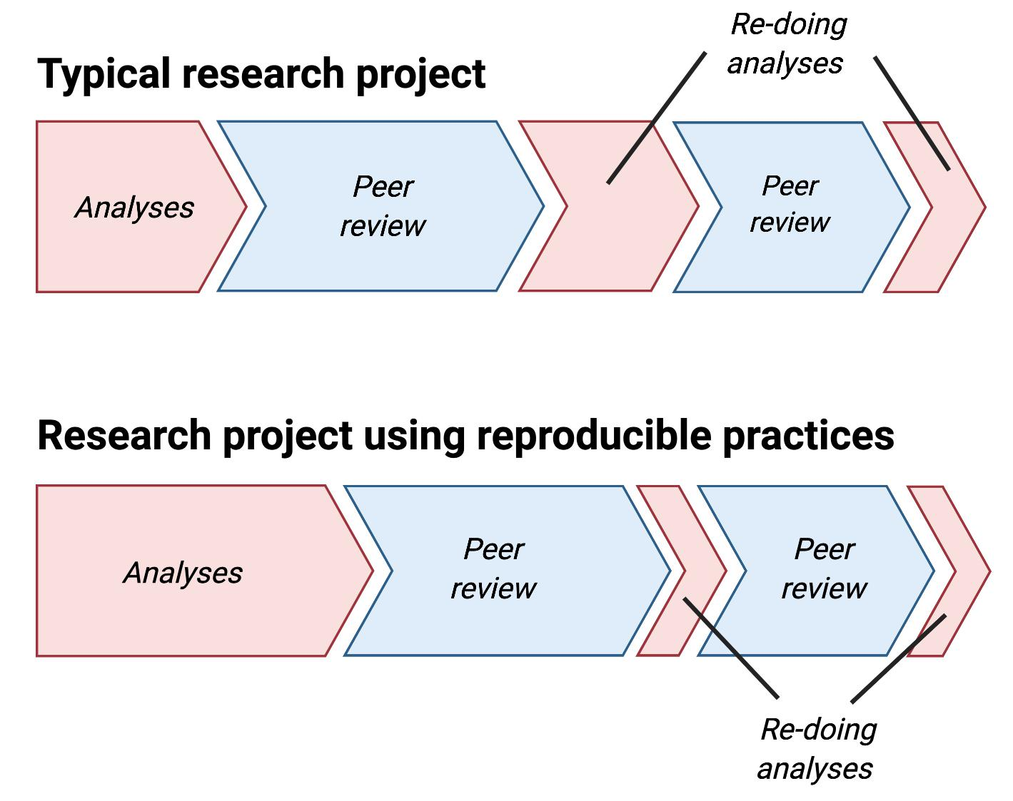
Quintana, D. S. (2020, November 28). Five things about open and reproducible science that every early career researcher should know. https://doi.org/10.17605/OSF.IO/DZTVQ
Notes:
And while better reproducibility to answer journal requirements might be the only way to introduce real change, let’s be clear that using reproducible practices is not something that you only do for you, but something that you can apply just for yourself! This is a recent tweet by Dan Quintana, who makes it clear that the extra time you might feel you have to spend in the beginning, really pays off later in the research process when you have to adjust you analysis, and even further down the road when you want to write your next paper.
Reproducibility is the basis for reusability and collaboration, and future you is your best collaborator.

Slide 19
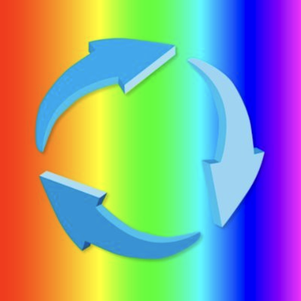

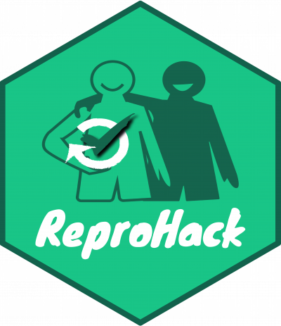
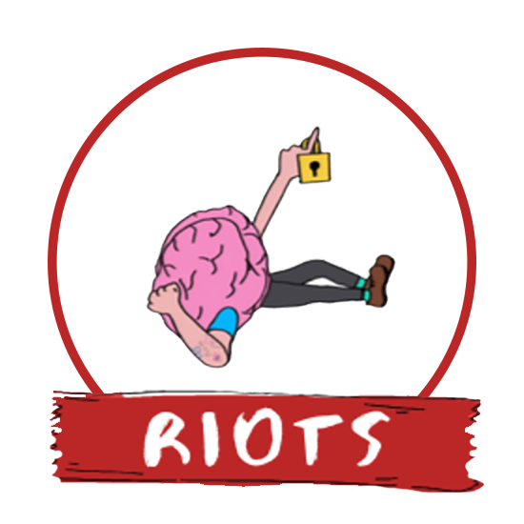
What can scientists do?
Take one step at a time.
Create and publish Research Compendia
(Your code is good enough!):
https://research-compendium.science/
Become a codechecker or reprohacker.
Join a Reproducibility 4 Everyone workshop.
Strive to be an open science champion especially if you’re junior in
your field. [RIOT talk by Gavin Buckinham; preprint by Sam Westwood]
Be the change, find communities, do not rely on those in power - they don’t know!
Notes:
[…]
And of course all of you should stay until the talk on GIN-tonic by Julien Colomb!
https://www.youtube.com/watch?v=3PCzWHJfz0g
https://psyarxiv.com/jyfr7

Slide 20
Research Compendia
= programming language packaging + science stuff
= templates
= community practices
(lab, discipline, language, method) research-compendium.science
Notes:
I also have no perfect resource for a “template” or approach.

Slide 21
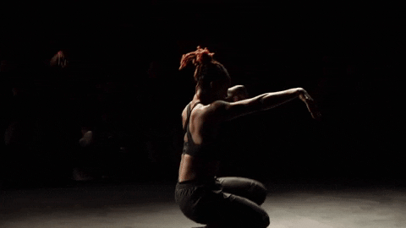
What can communities and institutions do?
Introduce reproducibility reviews - CODECHECK (or not) - at your journals, labs, collaborations!
Workshops on RCR, ReproHacks
Provide support
Establish rewards and incentives
Enable community discourse
Awareness > Change
https://giphy.com/gifs/chicagodancecrash-KCqjrcPfL55q3MkgHZ
Notes:
Introduce reproducibility reviews, top down if you’re an editor, or buttom up if your’re author or reviewer. Just do it, it will shift practice over time.
Become and advocate and educator! You can organise a workshop or a ReproHack, and help more and more community members build up the expertise to work more reproducibly. A lack of reproducibility is rarely intentional or supported by a strong opinion, but a lack of knowledge and rewards.
Create incentives and rewards.
Awareness leads to change. In the AGILE community, the team behind Reproducible AGILE was able to get from zero to six reproducible papers in three years, which I’m really proud of. However, I must admit this was only possible because we had institutional support.
We’re still working hard to find journals who want to establish CODECHECKs.
One tiny step at a time is still progress, and as this dancer shows us, you can still be very powerful and graceful.

Slide 22
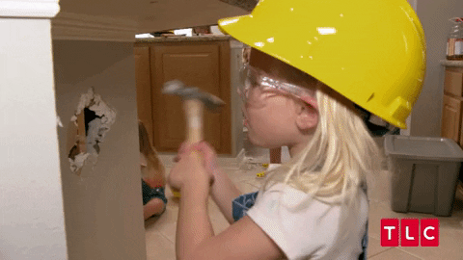

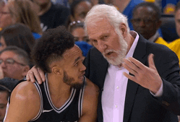
Learn crafts by doing. Be kind. Help.
Notes:
It’s a craft. Coding is a craft, reproducing computations is a craft. There is a reason why pair programming, for example, is used in software development.
I have been regularly asked about educational material for reproducing code, and my answer is: almost impossible to do it in a concise way, too many special cases. The best is to ty to do it and be kind to yourself and others.
For CODECHECK, for example, we would like to establish a mentorship programme, where an experienced codechecker helps others as they build up their skills.
https://giphy.com/gifs/TLCTurkiye-zRJUWfWxOgxJI9LwTL
https://giphy.com/gifs/work-working-beat-it-MZRVq2nKh6pQcCHD24
https://giphy.com/gifs/nba-expression-derrick-white-1n833bZxdzKzaErLe9

